Slide 1
DOELAP Webinar for Federal Oversight Personnel
May 16, 2023
WebEx

Slide 2
DOE Laboratory Accreditation Program
Required by 10 CFR 835, Occupational Radiation Protection
DOE Federal and Contractor Workforce – 132,392*
Number of Individuals Monitored – 72,830 (55%)*
Number with Measurable Dose - 14,912 (20% of monitored)*
Based on ISO 17025, Testing and Calibration Laboratories
*CY2017-2021 Average. DOE Occupational Radiation Exposure Report for CY 2021

Slide 3
DOE Laboratory Accreditation Program
Program Administration
DOE-STD-1111, DOELAP Administration
External Dosimetry (Similar to NVLAP)
DOE-STD-1095, DOELAP for Personnel Dosimetry
Established in 1986
Radiobioassay
DOE-STD-1112, DOELAP for Radiobioassay
Established in 1998

Slide 4
External Dosimetry
Assessment of exposure to radiation outside the body.
Accomplished by wearing a dosimeter for radiological work
Whole body
Extremity
Currently 24 DOELAP accredited programs
Supported by 35 volunteer assessors

Slide 5
Internal Dosimetry
Assessment of dose from radionuclides incorporated inside the body.
Indirect Radiobioassay (in vitro)
Estimate of radioactive material in excreta or in other biological material removed from the body.
Direct radiobioassay (in vivo)
Measurement of radioactive material in the body utilizing instrumentation that detects radiation emitted
Currently 18 DOELAP accredited programs
Supported by 32 volunteer assessors

Slide 6
DOELAP Team
David Pugh, DOELAP Administrator
Office of Worker Safety and Health Policy
Guy Backstrom, Director
DOE Radiological and Environmental Sciences Laboratory
George Chiu, Health Physicist
Office of Worker Safety and Health Policy
Steve Bohrer, Senior Technical Manager
DOE Radiological and Environmental Sciences Laboratory
Laird Bean, Assessment Coordinator
DOE Radiological and Environmental Sciences Laboratory

Slide 7
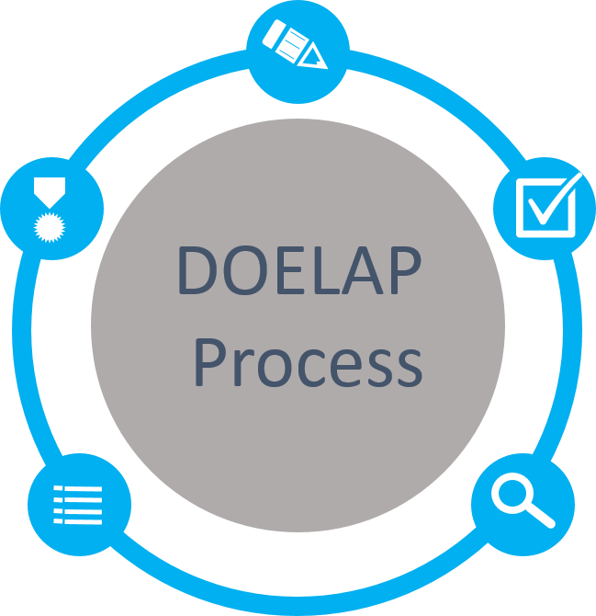
DOELAP Process
Application
Categories based on site requirements
Quality Assurance Program
Field Office Review
Performance Testing
ANSI N13.11, Personnel Dosimetry Performance Criteria and Testing
ANSI N13.32, Performance Testing for Extremity Dosimeters
ANSI N13.30, Performance Criteria for Radiobioassay
Accreditation
Period of 3 years
Notify DOELAP of changes
Memo goes to Field Office
Oversight Board Review
Complete Package
Recommendations to Administrator
On-Site Assessment
Direct observation and evaluation
Conducted by technical experts

Slide 8
Application
Correct contact info
Categories meet site requirements
Information is complete
Vendors/service providers
Vendors don’t apply separately
Sites include vendor information
11/18 radiobioassay programs use General Engineering Laboratories (GEL)
13/24 external dosimetry programs use Landauer
Sites must show ability to understand how vendors are performing work, receive and interpret data, test vendor performance, etc.

Slide 9
Field Office application approval

Slide 10
Performance Testing
Results are reported/evaluated for all required categories
When failures occur an acceptable CA is developed and followed through
Retesting
External dosimetry automatically enrolls the program in the next test cycle (6 month cycle)
Radiobioassay provides retesting samples out of the normal schedule (12 month cycle)
DOE-STD-1111-2018 allows for max of two retests
Sites should be tracking vendor failures
Sites are tested every 3 years. Current vendors tested yearly

Slide 11
On-site Assessment
Conducted by DOELAP-trained assessors
Generally 2-3 assessors over 2 days
Sites are responsible to invite DOE Field Office for opening and closing meetings
Assessors use DOELAP-created checklist based on relevant DOE standards
Checklists are available at https://www.id.energy.gov/resl/doelap/doelap.html
Follow up on previous corrective actions

Slide 12
Findings (DOE-STD-1111-2108)
Observation – suggested improvement or noteworthy practice, no response required
Concern – marginal compliance, but doesn’t have “significant, immediate, and continuing adverse impact” on quality
Develop and submit CAP to STM through Field Office within 45 days
Complete CAP within one year
Evaluate effectiveness
Deficiency – “significant, immediate, and continuing adverse impact” on quality. Results in suspension of application
Develop and submit CAP to STM through Field Office within 45 days
Complete CAs within 60 days of assessment close-out and submit evidence to STM
Evaluate effectiveness

Slide 13
Corrective Action Plans
Submitted by site to STM (through Field Office)
Short turn around, adequate root cause analysis?
STM reviews, sends to assessors for review
STM sends comments (if any) to site for CA revision
Final CAP sent to STM with FO approval
Must include estimated completion dates. Standard allows up to 1 year for completion. Should be realistic and risk-and evidence-based. Sites generally don’t need to take the full year.
OSB review may recommend accreditation with contingencies on CAP completion

Slide 14
Oversight Board Review
OSB made up of technical experts from various DOE sites
Role is to review recommendations made by the STM and advise the DOELAP Administrator regarding approval or denial of accreditation
Generally meets once per year
Review accreditation packets
Make recommendations
Not binding

Slide 15
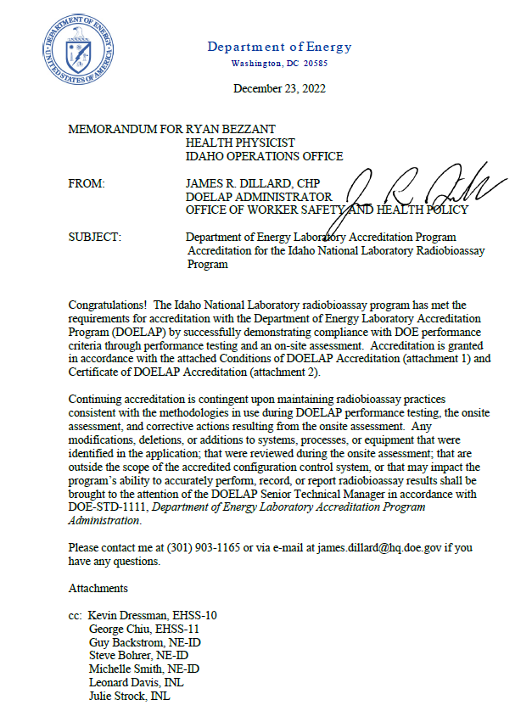
Accreditation
Memo from DOELAP Administrator to Field Office
DOE site holds the accreditation
Vendors are not DOELAP accredited or certified
Accreditation period is 3 years
Mid-cycle monitoring visits are possible

Slide 16
Technical Equivalency
Substantive changes to accredited program
Replacement of a major equipment component
Change in critical software
Change in a dosimeter algorithm outside of routine DOELAP performance testing
Major changes to or new methods or procedures
Not like-for-like replacement
TE request generally done by site in consultation with STM
Formal TE request comes through Field Office, and memo granting TE goes to Field Office

Slide 17
Oversight “Opportunities”
Management assessments
Blind audit program
Mid-cycle internal self-assessment to DOELAP checklist
Continuity of accreditation
Please notify us if you leave a position as Field Office POC

Slide 18
Program Updates
DOE-STD-1095-2018, DOELAP for Personnel Dosimetry
Continuation of Accredited Activities
Example Management Review Template added to Appendix
Continuation of Accredited Activities added to Management Review requirements
Clarification of Blind audit program requirements
Similar updates to STD-1112 planned after REVCOM comment resolution.

Slide 19
Assessor Opportunity
Assessor: individual recognized by DOELAP as a technical expert who has been trained and qualified to perform assessments in support of DOELAP accreditation process.
Send recommendation along with resume to Steve Bohrer, bohrerse@id.doe.gov.
Planned External Dosimetry Assessor Training at INL in September 11-12, 2023

